Slide 1
CRICKET MANAGEMENT SYSTEM
IST 659 – Data base management Systems
HARSH DARJI
NOVEMBER 26, 2018

Slide 2
Project Goals
Major functions of database systems are :
What data to collect
Team details are collected
Player details of various teams
Various metrics of Players
Match details for the fans
Best teams of each leagues

Slide 3
Project Goals
Who can Input the data
The league officials
Administrative staff
Who can query the data
The League officials
Administrative staff
Team owners
Fans

Slide 4
Project Goals
Why a fan queries the database:
To find match fixtures between different teams, what day, date and time the matches are held.
To view which players play for which club.?
To view who is the most valuable player
To view the team with most points
To view the young players from a particular team with good number of runs

Slide 5
Project Goals
Why the league officials query the database:
To set which players are playing which matches (on what day, date and time the match is between which teams and on which stadium the match is held and played by which player )
To reward the most valuable player
To reward the player from a particular team with most wins
To view the team with most points
The administrators assigned by the officials must have the administrator rights to access all the databases.

Slide 6
ER Diagram - Visio

Slide 7
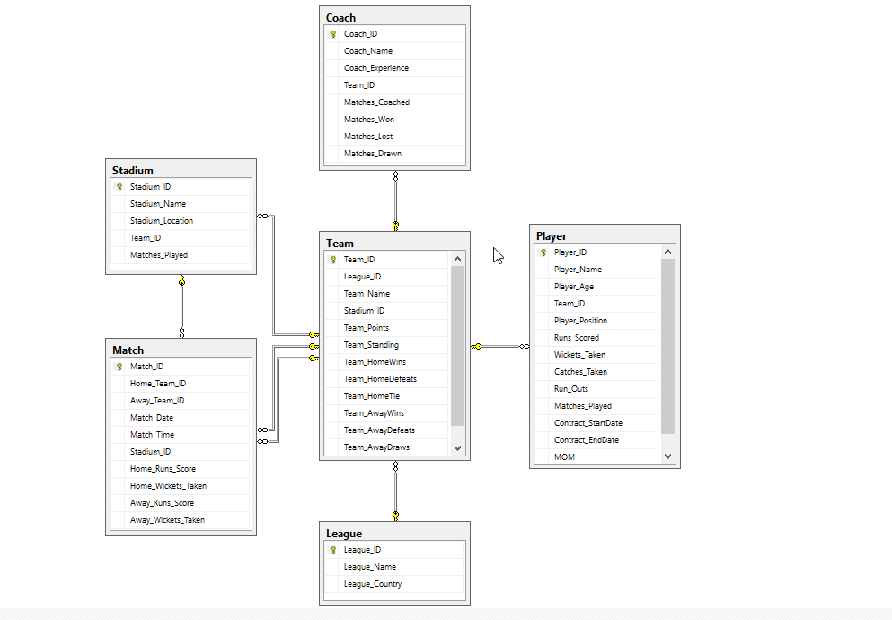
ER Diagram - sql

Slide 8
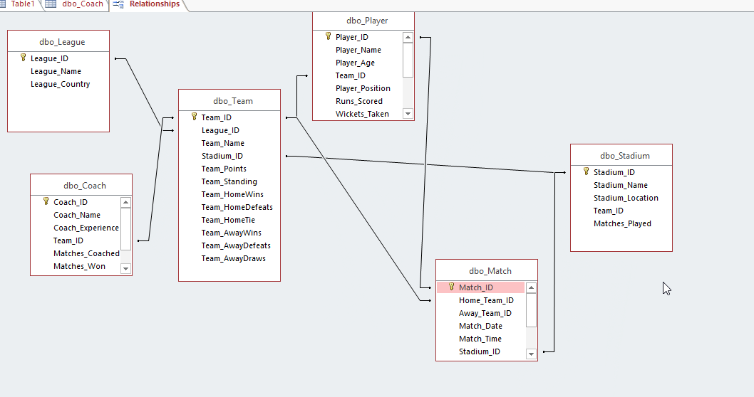
ER Diagram – Access Relationship Diagram

Slide 9
Forms
Total Number of Tables : 6
Total Number of Forms : 20
Number of Forms that you created so far : 10
FAN PAGE:
View Matches
View Teams
View Players
View Top Run scorers

Slide 10
Forms
Admin PAGE:
TEAM DATA
TEAM PLAYERS DATA
MATCH DATA
STADIUM DATA
LEAGUE DATA
TEAMS WITH MOST POINTS
TOP RUN SCORER
TOP WICKET TAKERS

Slide 11
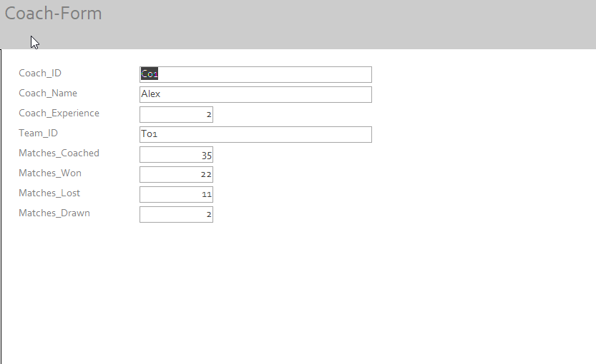
Forms

Slide 12
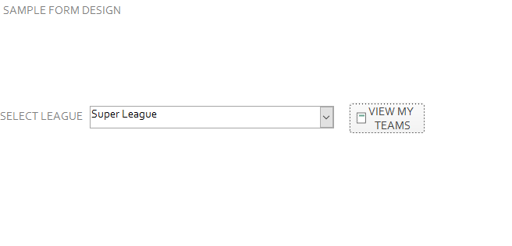
Forms

Slide 13
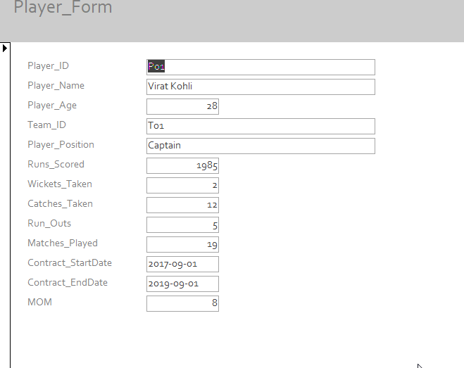
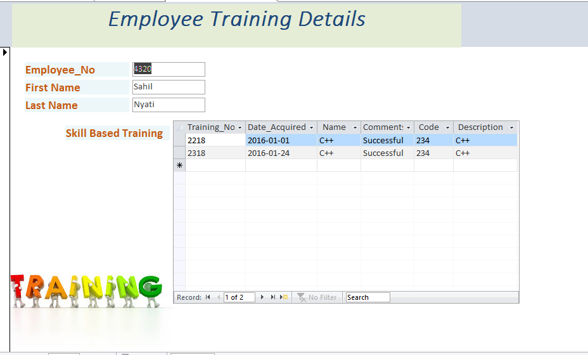
Forms

Slide 14
Major Data Questions- Reports
Teams with most number of wins in each league with their points.(y)
Which team has won most number of matches?(n)
Which player has won most number of matches?(n)
Which palyer has scored most number of runs in minimum number of matches ?(n)
Which palyer has taken most number of wickets in minimum number of matches ?(n)
Which palyer has taken most number of catches in minimum number of matches ?(n)
* All question related to players

Slide 15
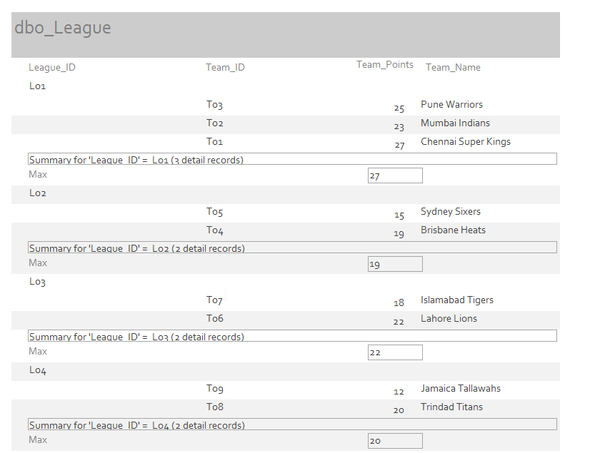
Report 1
Teams with most number of wins in each league with their points.(y)

Slide 16
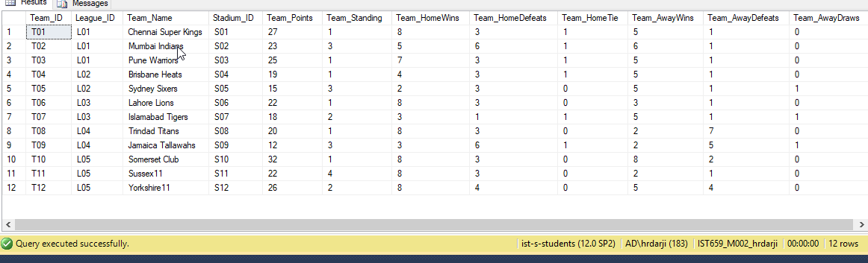
Trigger
Before Trigger team points are 27

Slide 17
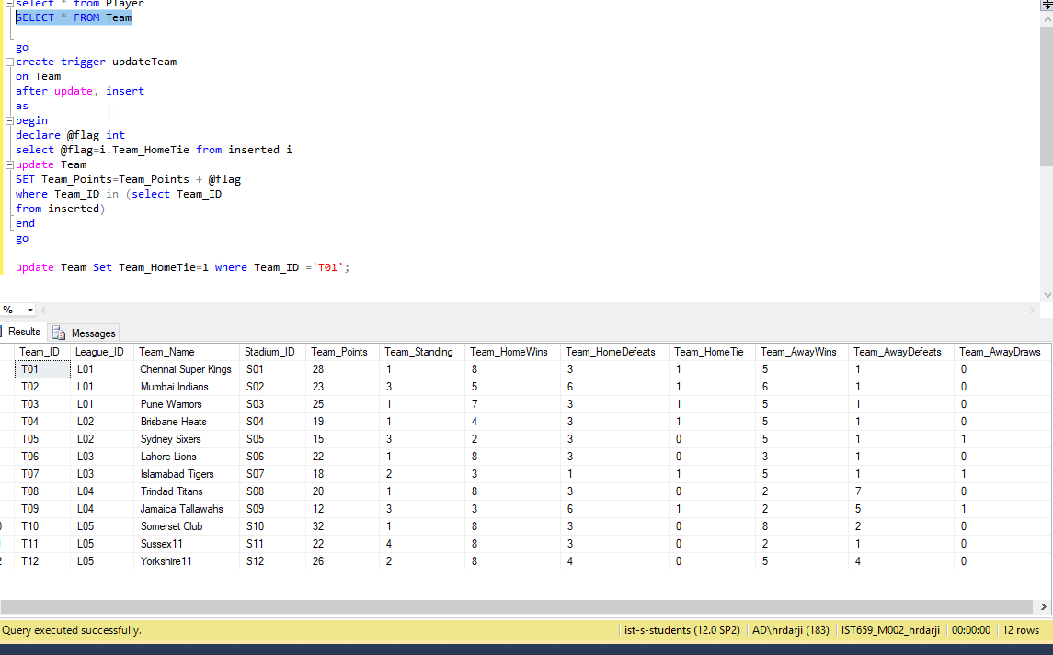
Trigger
After trigger Team points are 28

Slide 18
Trigger
select * from Player
SELECT * FROM Team
go
create trigger updateTeam
on Team
after update, insert
as
begin
declare @flag int
select @flag=i.Team_HomeTie from inserted i
update Team
SET Team_Points=Team_Points + @flag
where Team_ID in (select Team_ID
from inserted)
end
go
update Team Set Team_HomeTie=1 where Team_ID ='T01';

